Slide 1

Crime Visualization
Group Number => 002 Section Number => 002
Dharmik Patel – 0813537
Arjun Patel - 0812257
Mayur Parmar - 0811597
Manav Patel - 0804383
Deep Chaudhary - 0813502

Slide 2

DAB103 CRIME DATA ANALYSIS
Introduction of the dataset
Outliers
Data cleaning and data transformation
Data analysis
Conclusion

Slide 3
Background
Nowadays many crimes happen in this world. So its necessary to police officers to track every criminal record and access it quickly as soon as possible.
In addition, Public is not aware about the rate of crime, reported crime and cleared crime according to the category of the crime.
In this project our dataset focuses on crime in Toronto, Canada between the years of 2014 and 2021. The data focuses primarily on the type of Reported Year, Geo Division, Category, Subtype, Count.

Slide 4
Problem Statement
Visualize the crime rates with category wise and their insights from historical data available at police records by examining the crime data from various angles like location, type of crime, and similarities to prepare prediction model. E.g. – most number of crime recorded in specific area, most type of crime over a years.
If the police aware about the difference between reported and cleared crime so they can identity easily the crime rate and also know which area is with the most crime with the category.

Slide 5
Project Proposal
ANALYSIS QUESTIONS:
What are the count of crime according to the type of crime?
What are total reported crime and cleared crime?
How many crime reported according to different area of Ontario?

Slide 6
1. INTRODUCTION OF THE DATASET
Describe the data : We got this dataset from Toronto police service.
Link : https://data.torontopolice.on.ca/datasets/TorontoPS::reported-crimes-asr-rc-tbl-001/about
This data Published on July 5, 2022 from the Toronto Police Service PUBLIC SAFETY DATA PORTAL. It contains 2701 rows and 7 columns.
Identifying missing, incomplete or invalid records using pandas
Make changes in dataset using pandas. In this we have added one extra column that is address of division of police station.
Identify data elements that are highly correlated with each other. E.g. We have group by the category, count and did also visualization.
Identify units of measurement for columns (Integers)
Using heatmap we have find the correlation among all the agents.
After that we also find the longitude and latitude according to the address and also did the map.

Slide 7
Dataset Description
Index | Field name | Field Description
01 | Index | Unique identifier
02 | ReportedYear | Year crime was reported
03 | GeoDivision | Geographic division crime took place
04 | Catagory | Crime Catagory
05 | Subtype | Crime Category Subtype
06 | Count | Total number of crimes
07 | CountCleared | Total number of crimes Identified as cleared

Slide 8
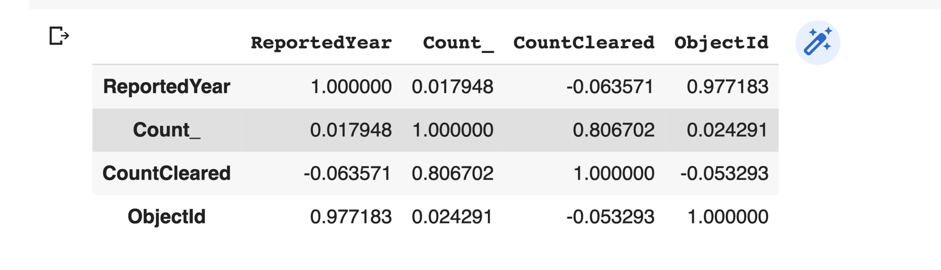
It shows the correlation of the crime dataset.

Slide 9
2. OUTLIERS
We have four outliers which are controlled drugs and substances act, crimes against property, crimes against the person, criminal code traffic, criminal code violations and other federal statute violations.
Calculation of outliers,
Finding IQR = quartile(q3)- quartile (q1)
Lower_bound = q1 – (1.5 * iqr)
Upper_bound = q3 + (1.5 * iqr)

Slide 10
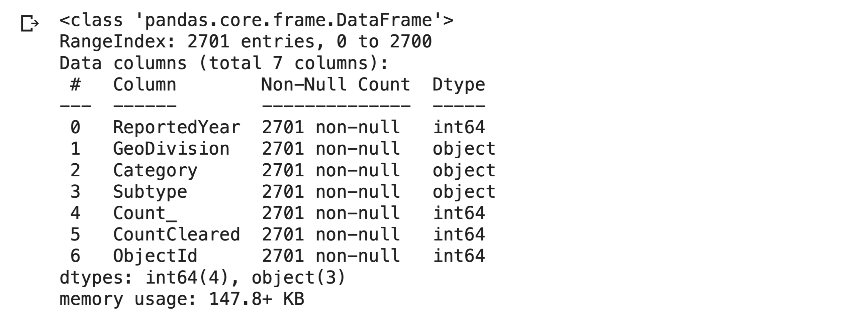
3.Data cleaning and data transformation
We don’t have any NULL values in this dataset.

Slide 11
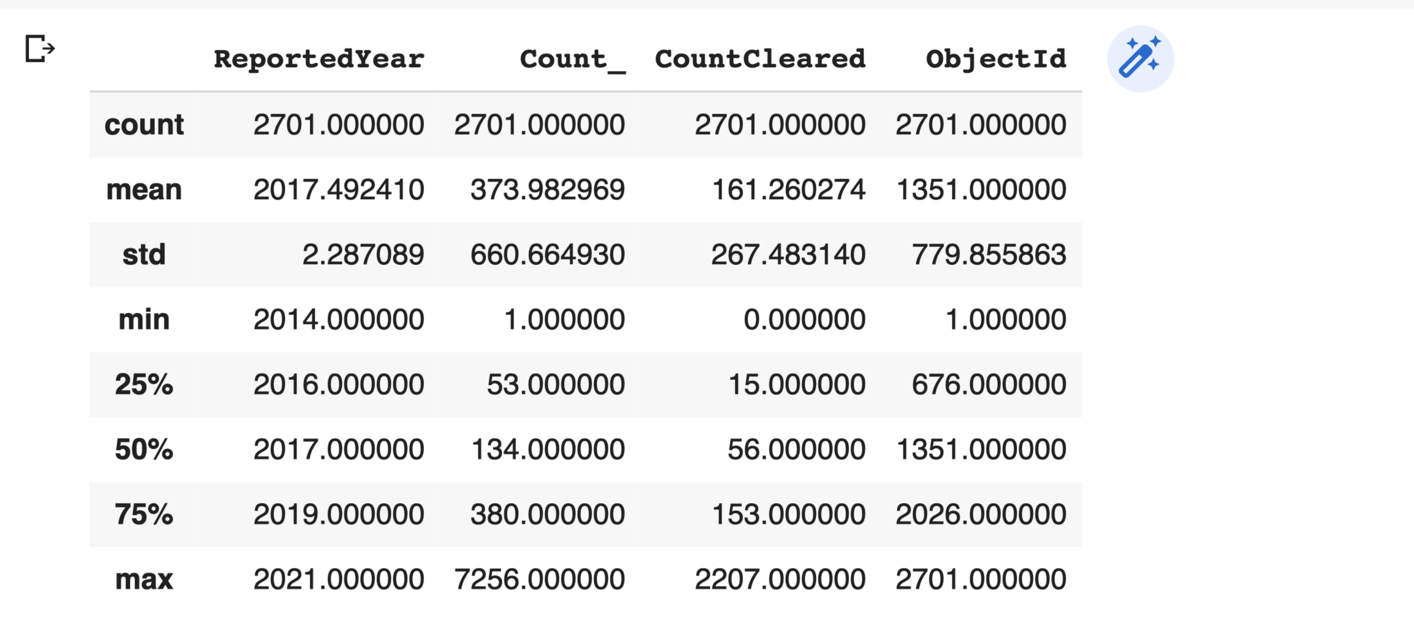
Describing Crime dataset methods :

Slide 12
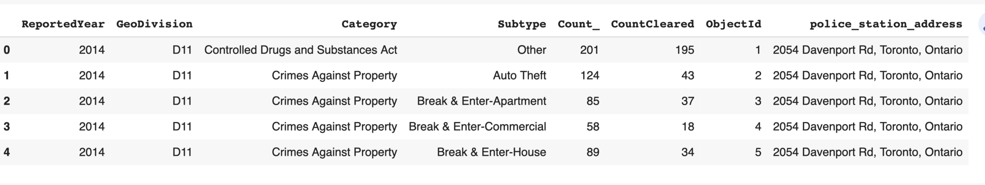
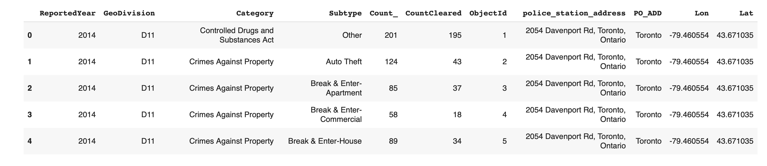
We add an address of reported crime from GeoDivision, after that, we split the address from the basis of states so that it can easily identify how many crime rates happen from the basis of states.

Slide 13
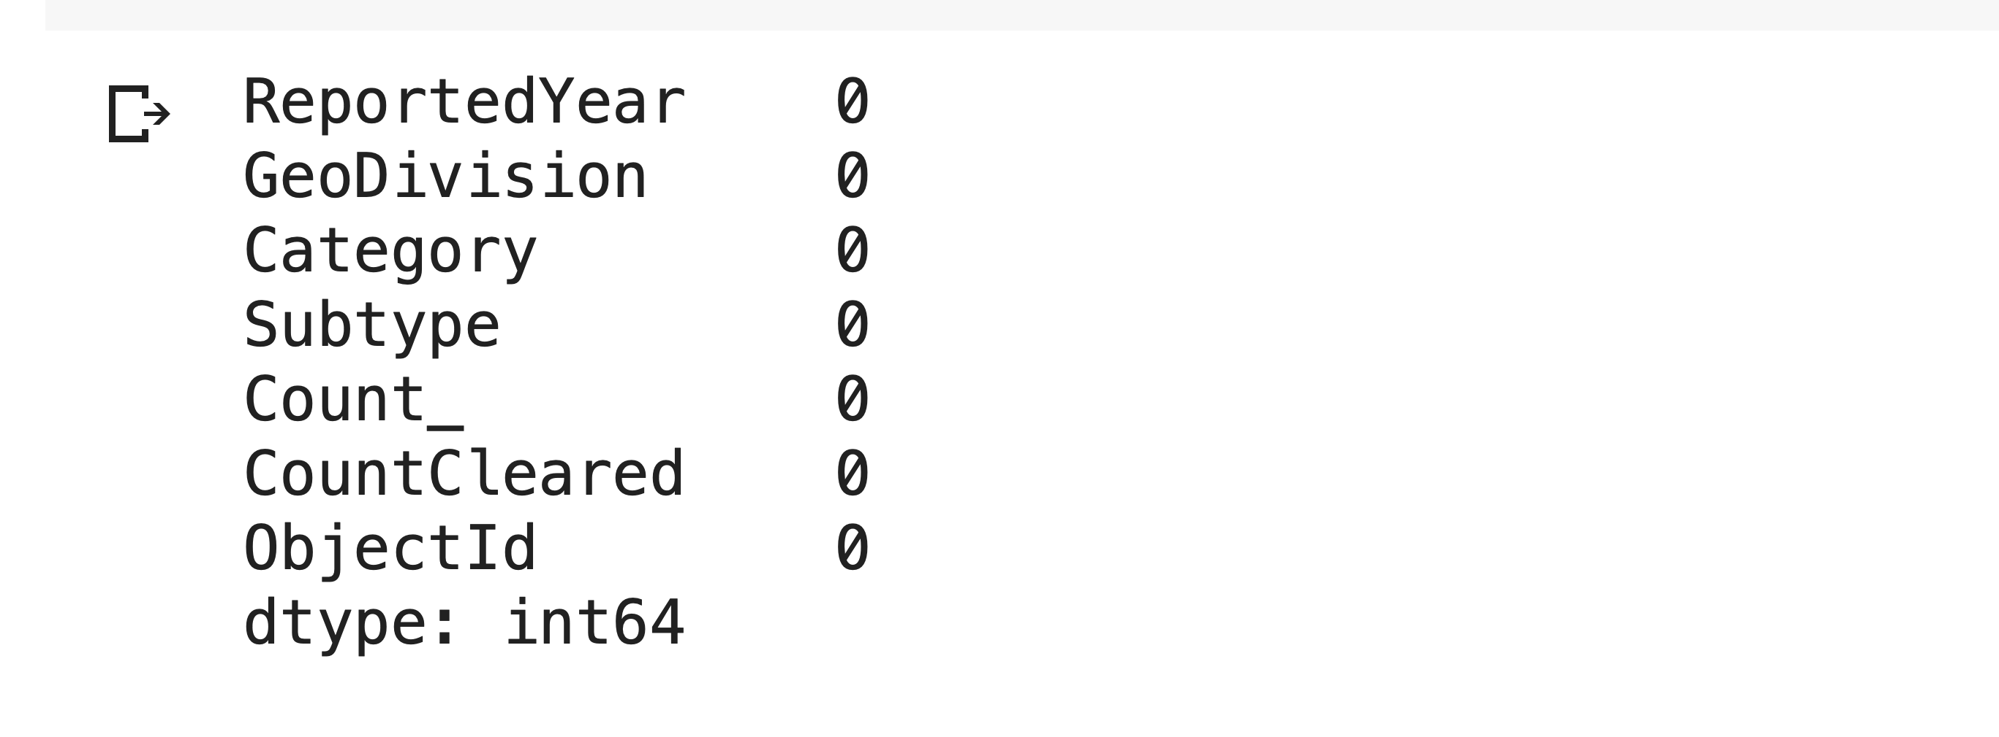
We added longitude and latitude for a Geolocation on a map which can be described the location of the crime rate reported.
As shown on the info method, have zero NULL values.

Slide 14
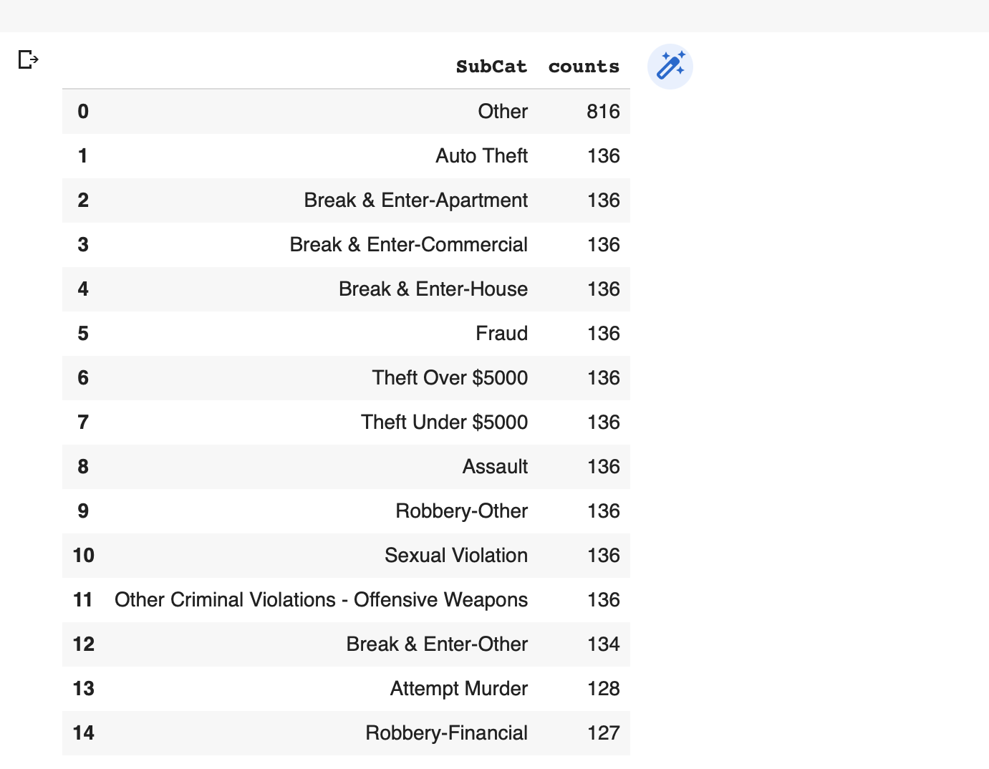
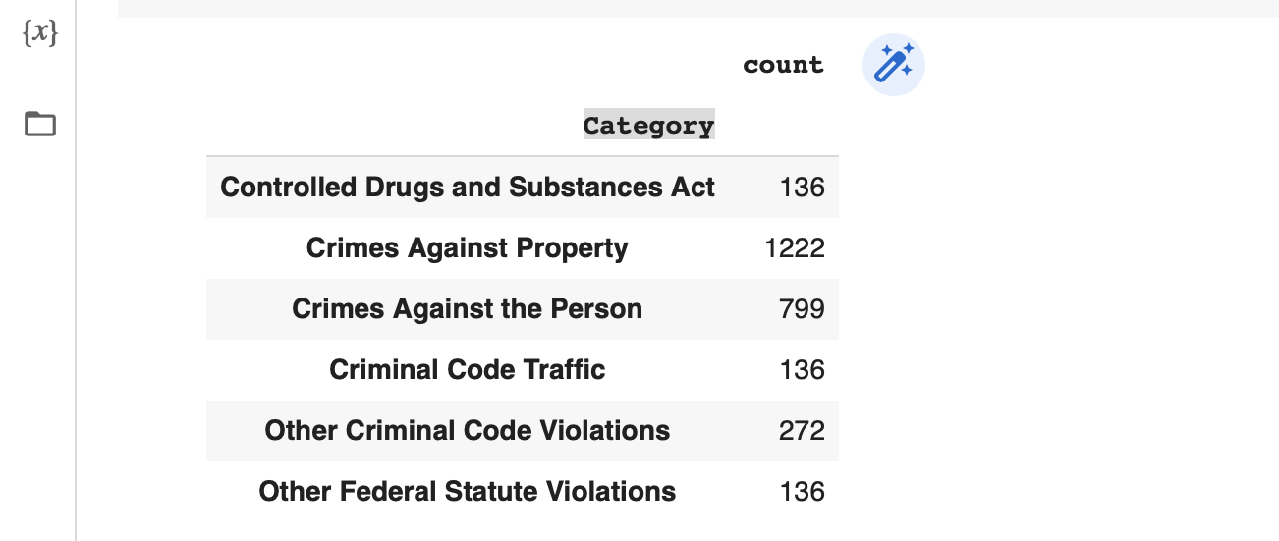
2.1 Data transformation
Making a data frame for such a category of crime and transforming data Geodivision to the crime-reported address. it can see in data cleaning.

Slide 15
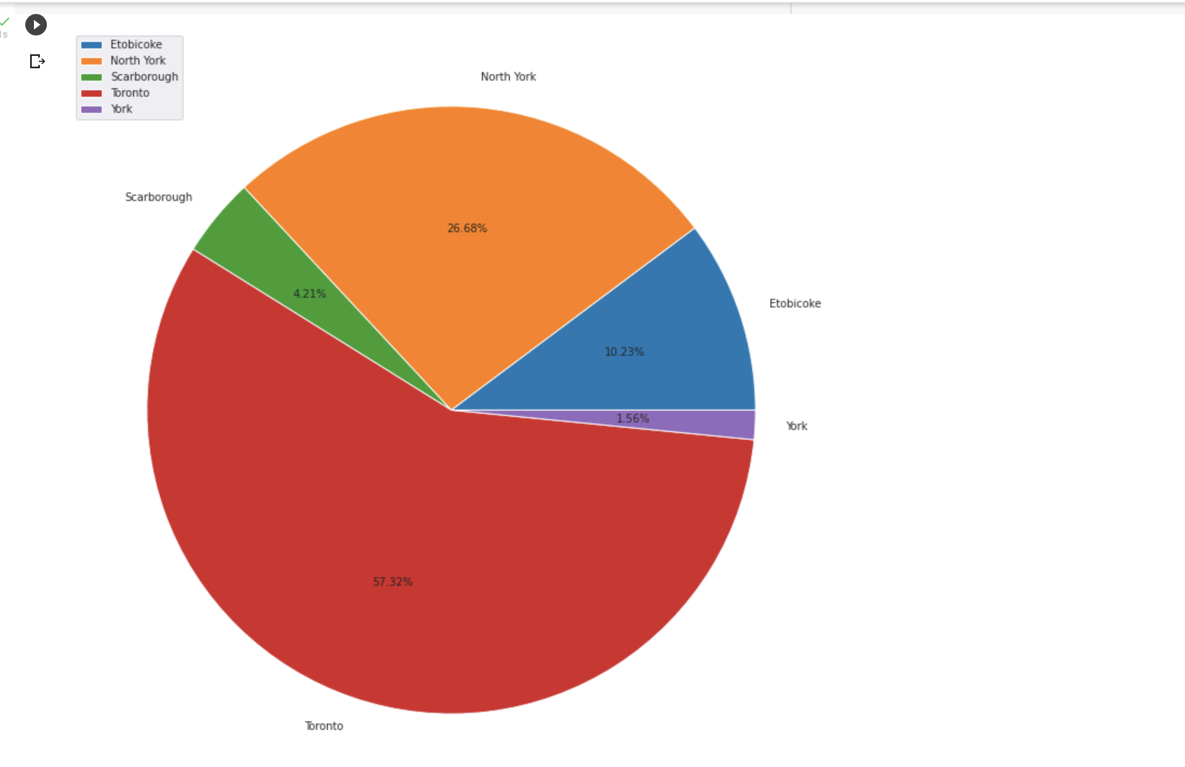
4. Data Analysis
In that bar graph,
We analyze five states state count which is explained below,
Toronto gets solved the highest amount of data which is 57.32 while north York was around 27%, Etobicoke had the 10.23%, Scarborough has the 4.21% and York has the 1.56% respectively.

Slide 16
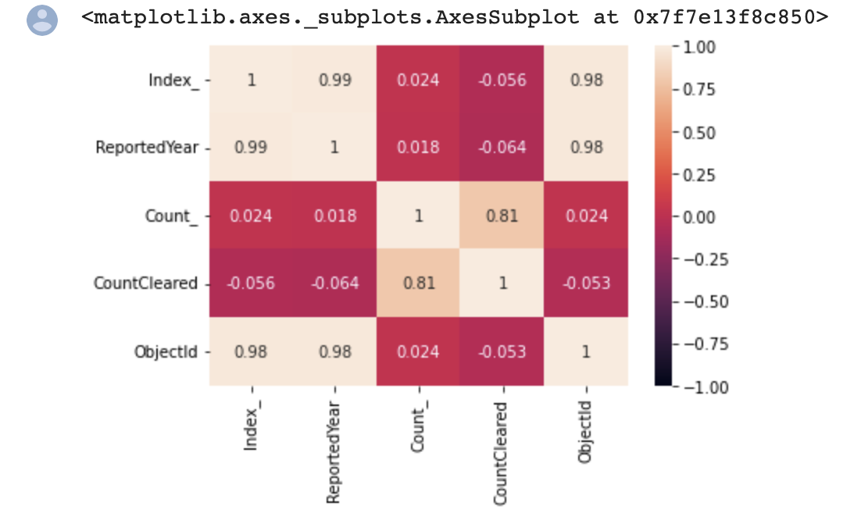
Visualization
Heatmap : For Correlation among all the columns

Slide 17
Visualization Description
Importantly, Crime count and clear count are the highly corelated by this mean most of the crime rate clear by the Canada police.
And other category like reported year and crime count, clear crime count and other categories not highly corelated.

Slide 18
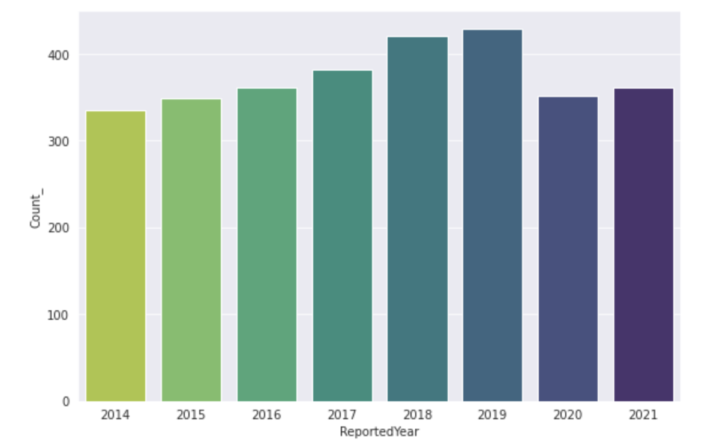
In all over crime rate, year 2019 committed highest crime and 2014 committed lowest crime rate which can be analyzed by below graph.
Reported Year with count

Slide 19
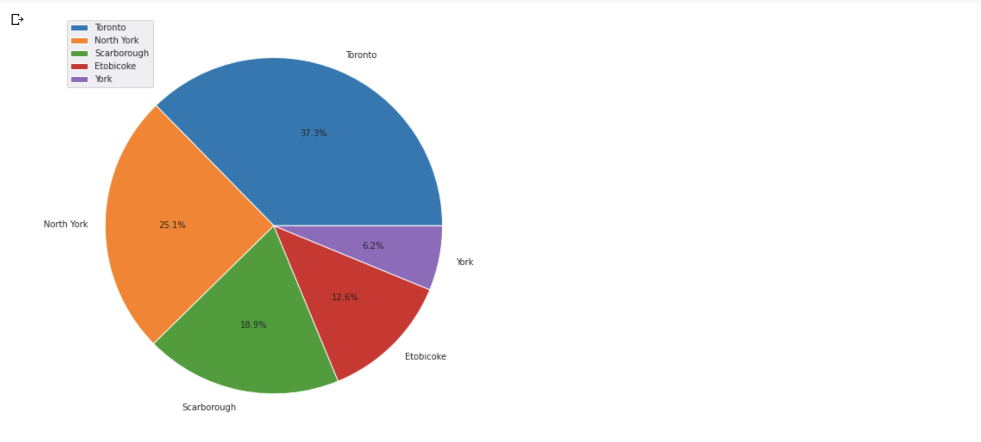
In the above graph, crime count shows in different states, in that Toronto has the highest, 37.3% and York has the lowest 6.2%.

Slide 20
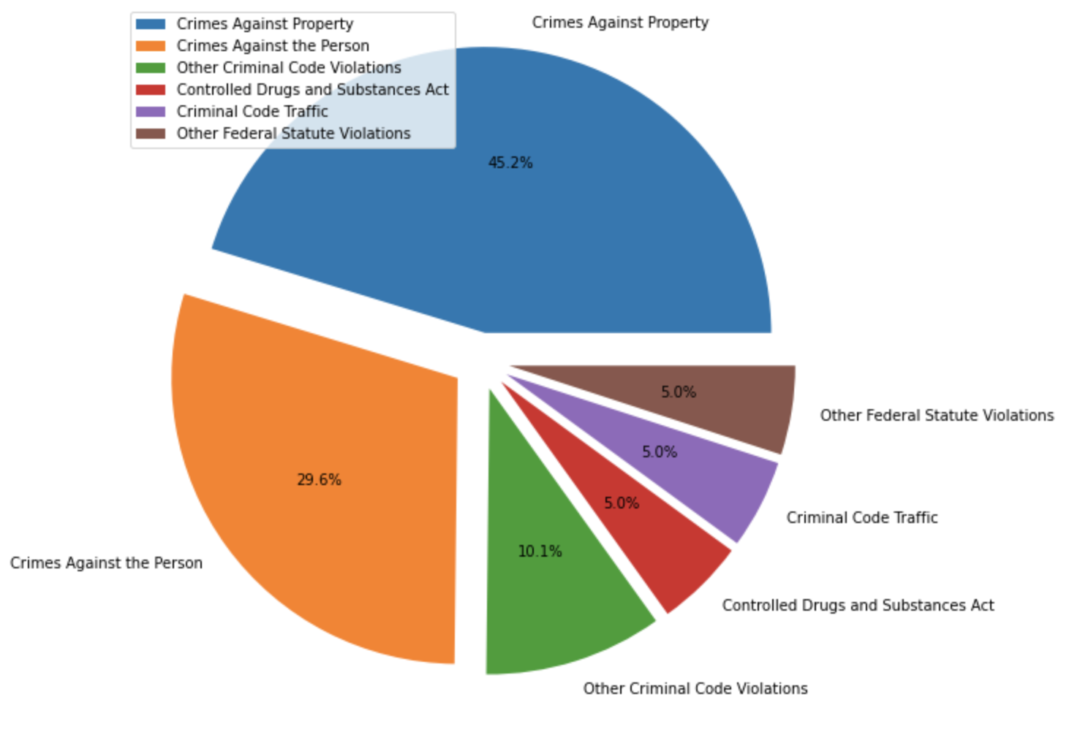
Category wise Crime rate

Slide 21
Visualization Description
In a crime visualization, crime against property is highest compared to other categories in crime rate.
Crime against the person covered 30% in all over the crime rate.

Slide 22
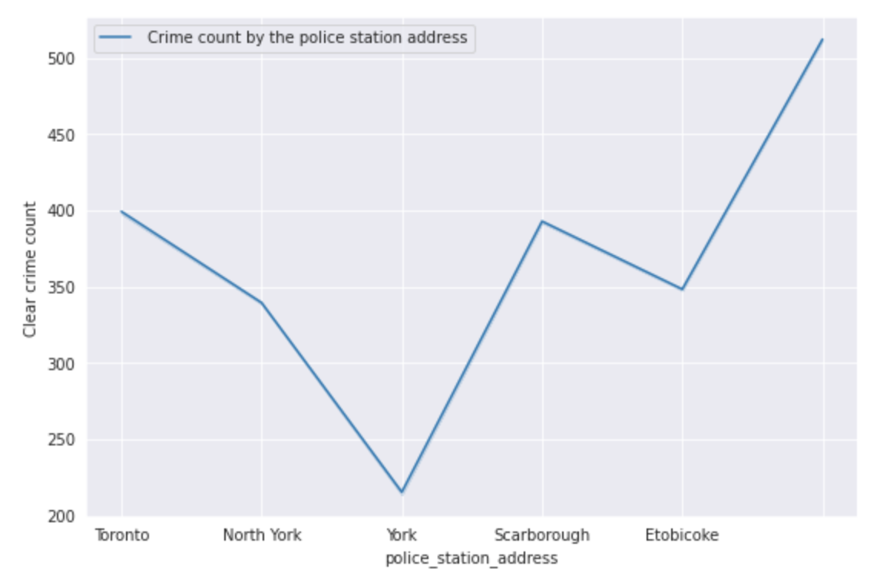
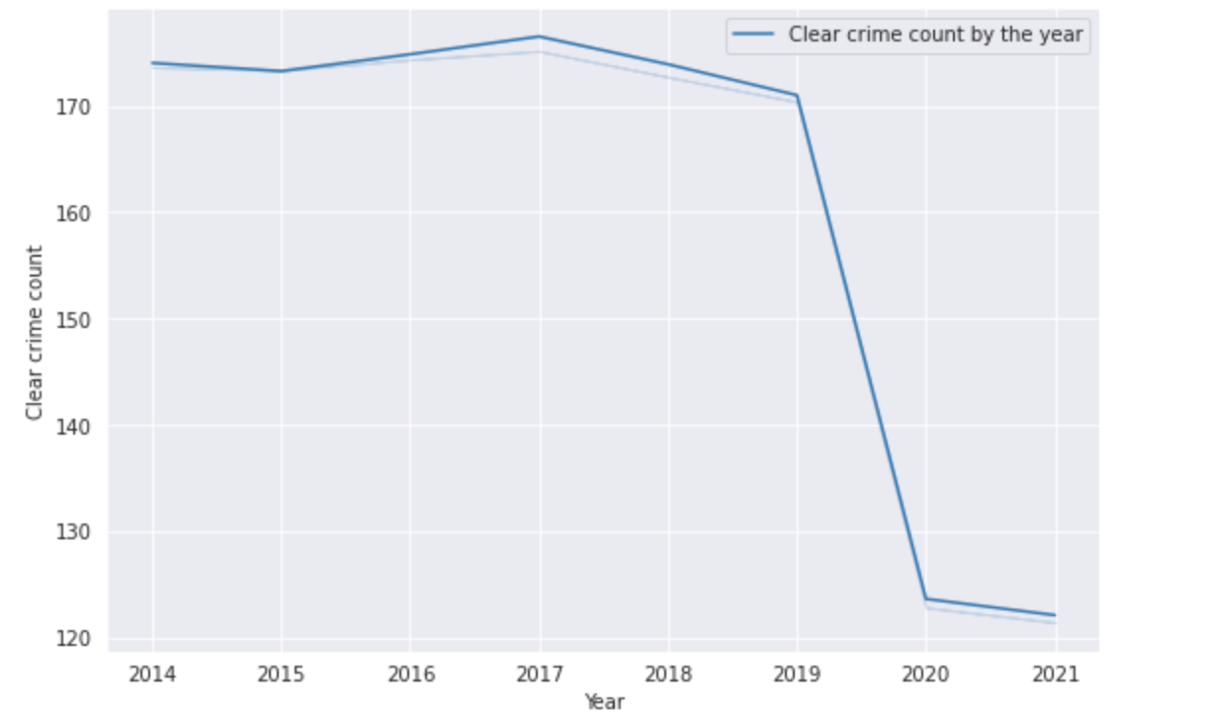
Etobicoke commuted highest clear crime count compared to other and Toronto is the second one which contains highest clear crime count.
In the year of 2019 has the highest clear crime by the police.
Crime cleared count with year and area wise

Slide 23
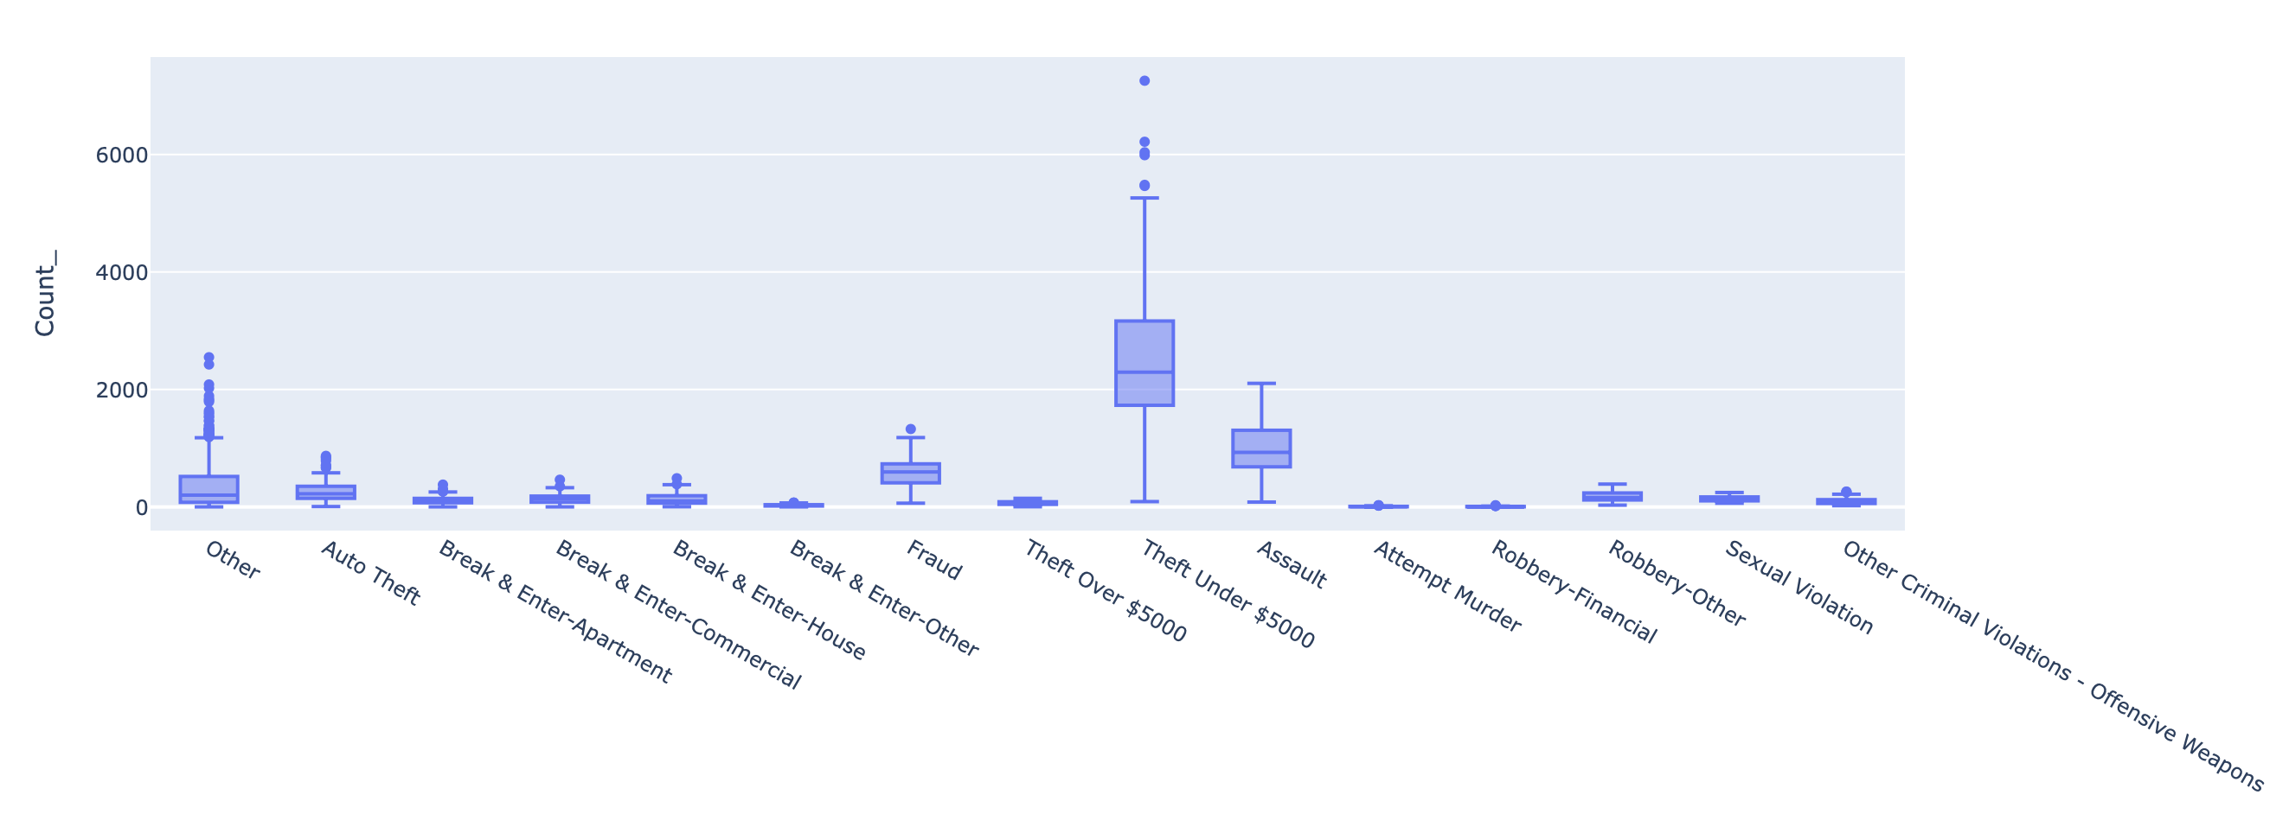
Subtype of crime and its count with two different charts.

Slide 24
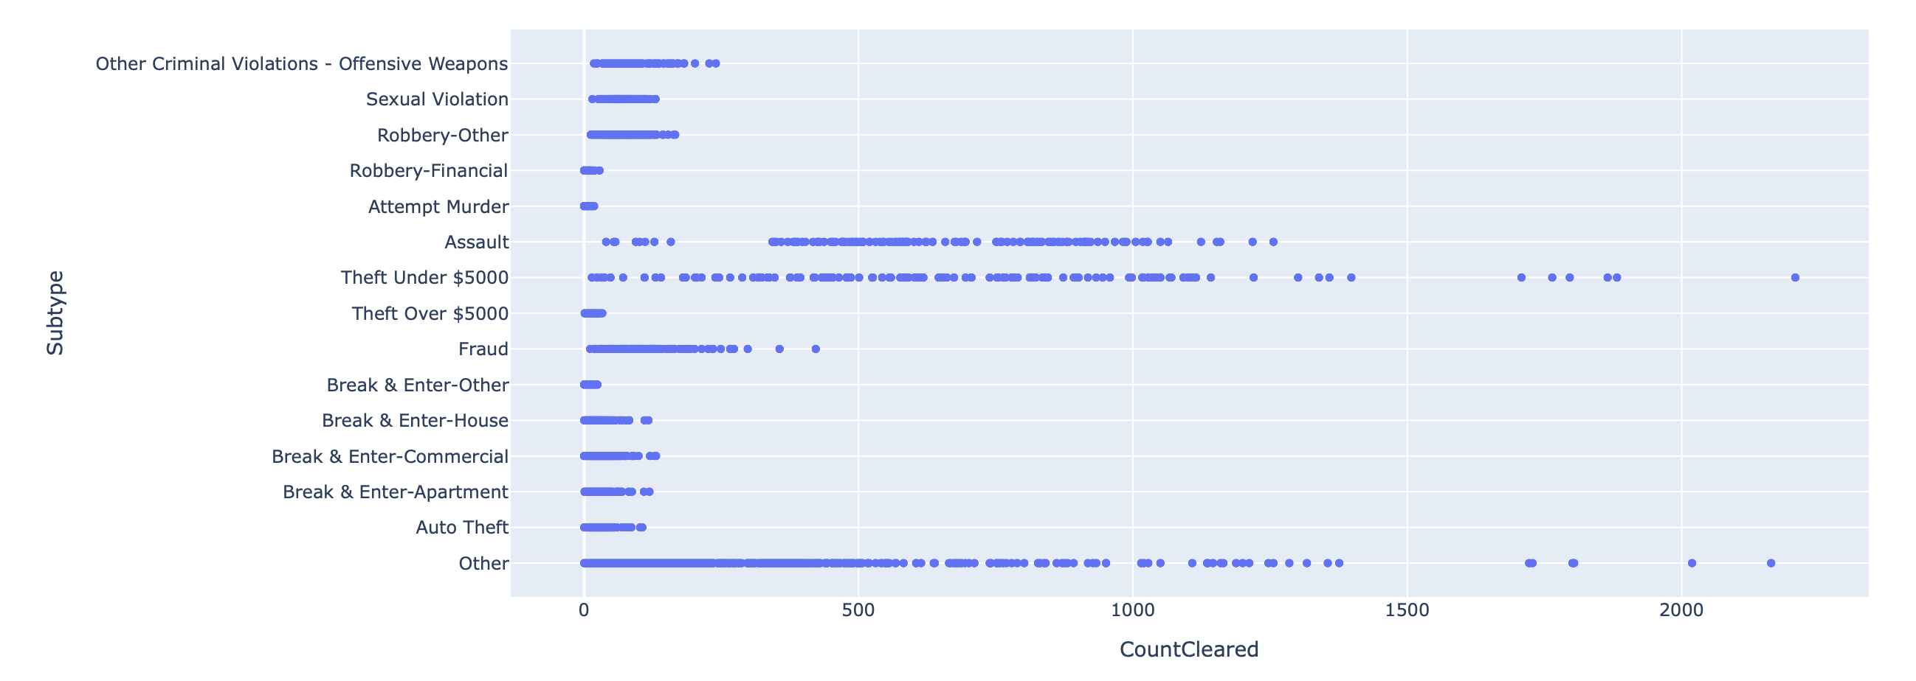

Slide 25
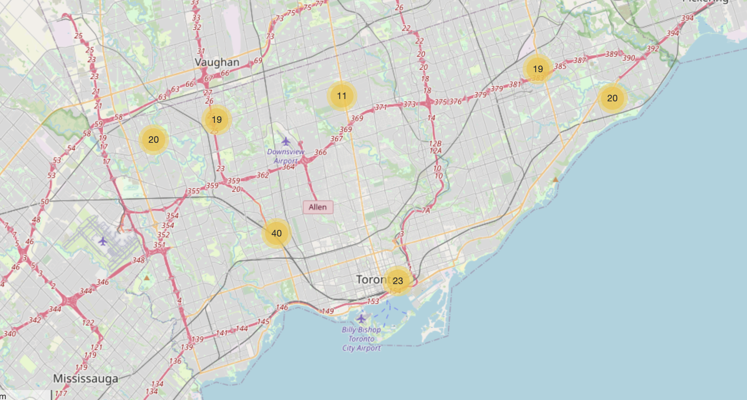
In below map, we can see the locations of the police stations that contains number of reported crime.
Live Location and its reported Police station crime count using map.

Slide 26
5. Conclusion
It is clear from the visualization, the reported cleared crime ratio little bit less compare to the crime rate.
More crime happens in Toronto however, it is also clear 99% in Toronto compare to other provinces.
Most crime rate reported in the year of 2019 as compared to other years.
Theft of money and assault are the most significant crime.

Slide 27
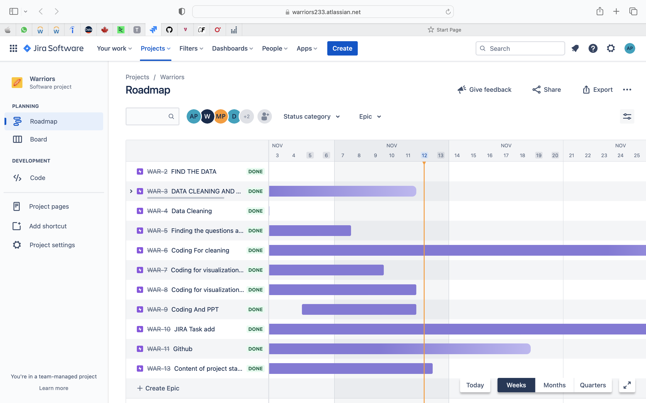
JIRA
https://warriors233.atlassian.net/jira/software/projects/WAR/boards/1/roadmap

Slide 28
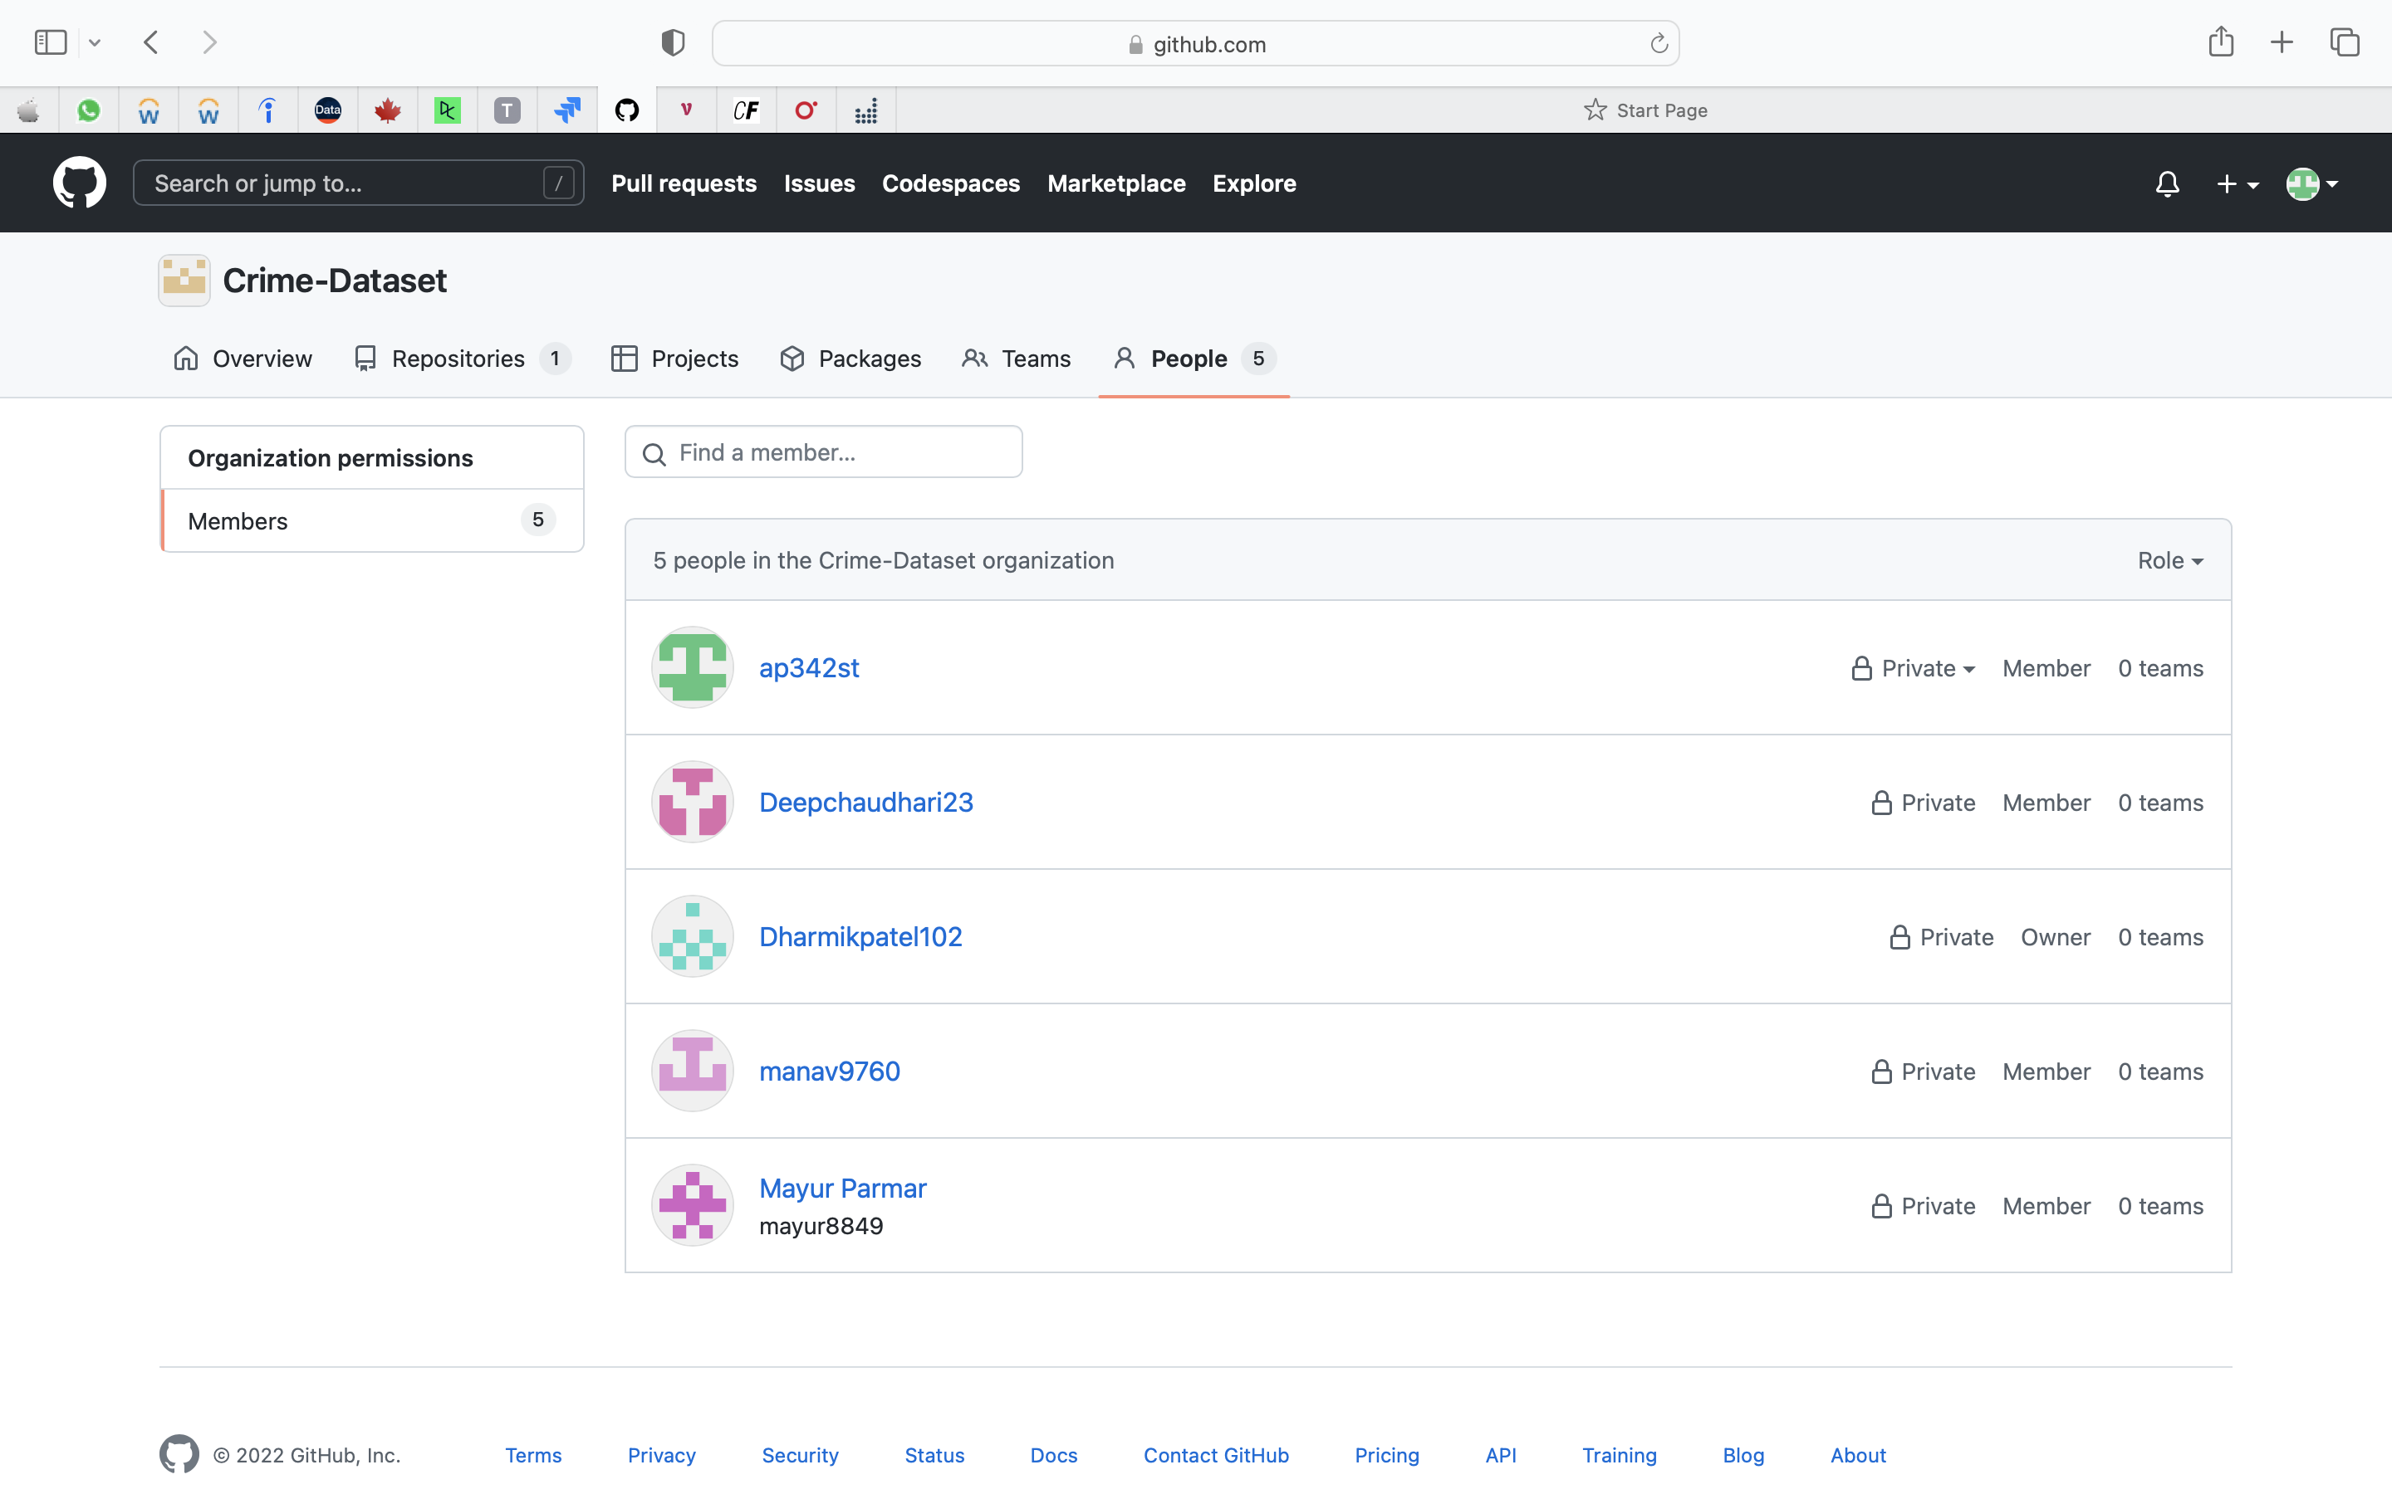
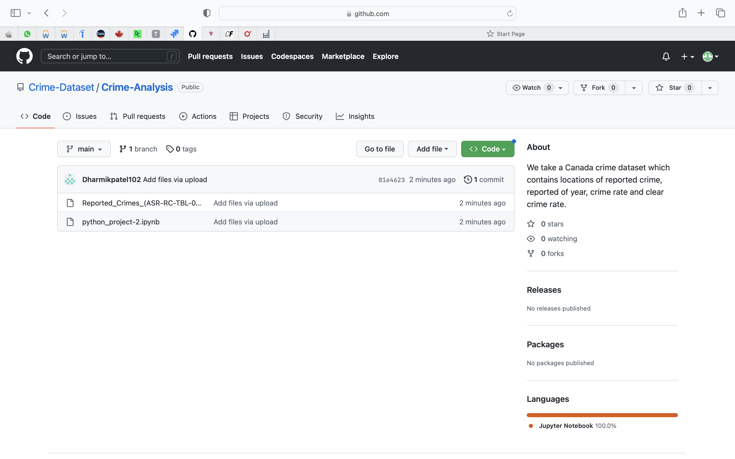
GITHUB
https://github.com/Crime-Dataset/Crime-Analysis

Slide 29
Thank you

